Slide 1
Analyzing Loan Application Data Using Python

Slide 2
Problem Statement
A “Consumer Finance Company” specialize in lending loans to customers. They are interested in understanding the patterns in the
clients who has difficulty in paying installments. These features can help in identifying such loans applications and can lead
to denying the loan, reducing the amount of loan, lending (at a higher interest rate) and, thereby improving there portfolio and risk assessment .

Slide 3
Abstract
Analysis Design
The analysis is broadly divided into three steps
Exploratory analysis to understand the data set, clean the data set, and identify key column for the analysis
Perform univariate, bivariate, and multivariate analysis for target categorical and numerical variables
Identifying the variables which can help in predicting high risk customers
Some important variables which we consider from domain are as below
TARGET: Customers who have delayed at least one payment, will be a primary variable in relation to which other variable are analysed.
NAME_CONTRACT_STATUS: Status of previous loan applications, will serve as an important variable for analysis.
Assumption
We do not know how many payments a customer missed. All the customers, with at least one missed payment, will be treated equally

Slide 4

Exploring Data Sets
This is the first step of analysis and focus was preparing the data set to perform predictive analysis
Understand the
This step was focus on
Dropping columns with missing value
Develop approach to treat outliers
Fixing the column with
incorrect data types
In this step, objective was
data dimensions
Column types
Identify the columns with missing value and outliers
Creating required columns(binning)
Dropping irrelevant columns
Creating required data
frame

Slide 5
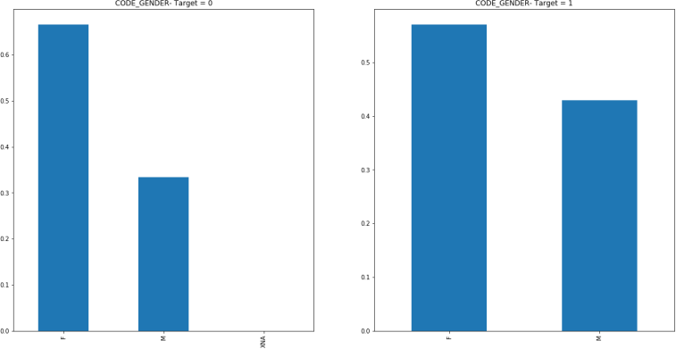
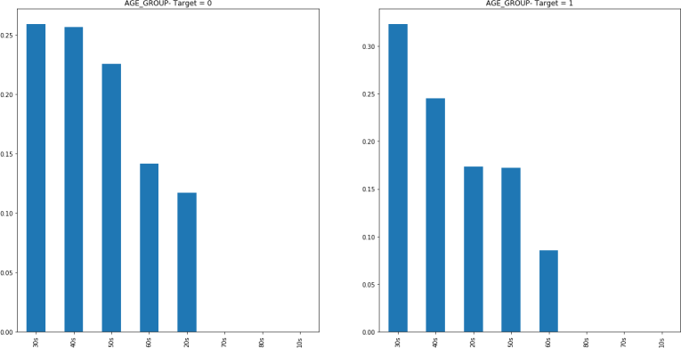
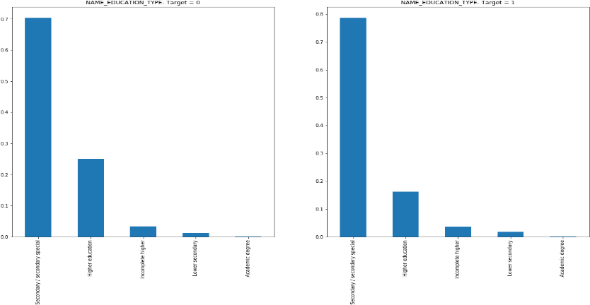
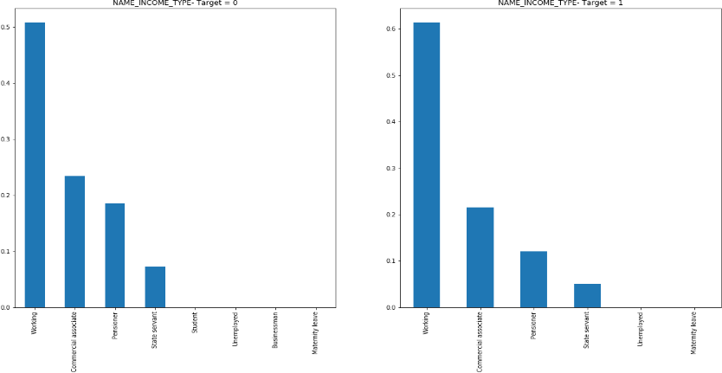
Exploring Data Sets – Categorical Variable
Univariate Exploration
We explore data set available to understand how the defaulters(target =1) and non-defaulters(target =2) are distributed around various variables
Identification:
Fig 1: Gender - defaulter has
higher percentage of male
Fig 2: Age Group - Higher proportion of customers in 30s
Fig 3: Education - Higher percentage of secondary educated in defaulter
Fig 4: Income type- higher proportion of working type in defaulter

Slide 6
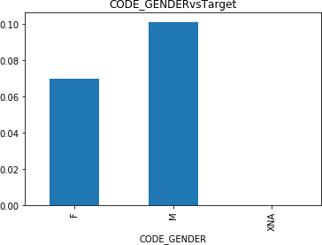
Exploring Data Sets – Categorical Variable
Bivariate Exploration
We explore the data set to understand how loan default and gender are related
Identification:
It indicated male have a higher probability of defaulting (~10%) in comparison to female(~7%)

Slide 7
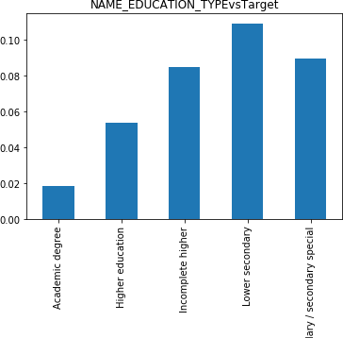
Exploring Data Sets – Categorical Variable
Bivariate Exploration
We explore the data set to understand how loan default and education type are related
Identification:
It indicated lower secondary have a higher probability of defaulting (~11%) in comparison to any other education type

Slide 8
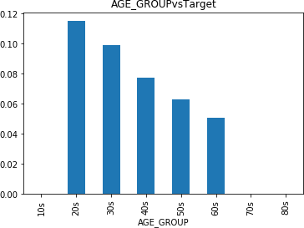
Exploring Data Sets – Categorical Variable
Bivariate Exploration
We explore the data set to understand how loan default and age group are related
Identification:
It indicated customers in 20s and 30s have higher risk of defaulting(>10%)

Slide 9
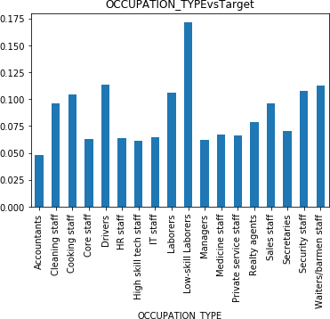
Exploring Data Sets – Categorical Variable
Bivariate Exploration
We explore the data set to understand how loan default and occupation type are related
Identification:
It indicated customers working as low skill laborers have higher risk of defaulting(~17%)

Slide 10
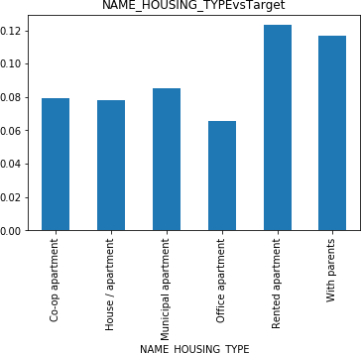
Exploring Data Sets – Categorical Variable
Bivariate Exploration
We explore the data set to understand how loan default and housing type are related
Identification:
It indicated customers living with parents and in rented apartment have higher risk of defaulting(>10%)

Slide 11
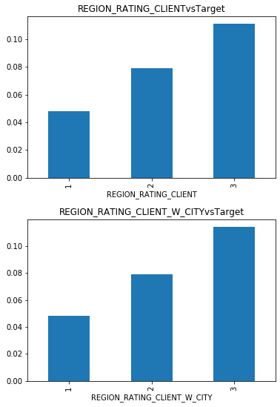
Exploring Data Sets – Categorical Variable
Bivariate Exploration
We explore the data set to understand how loan default and region rating are related
Identification:
It indicated customers living in region rating 3 have higher risk of defaulting(~10%)

Slide 12
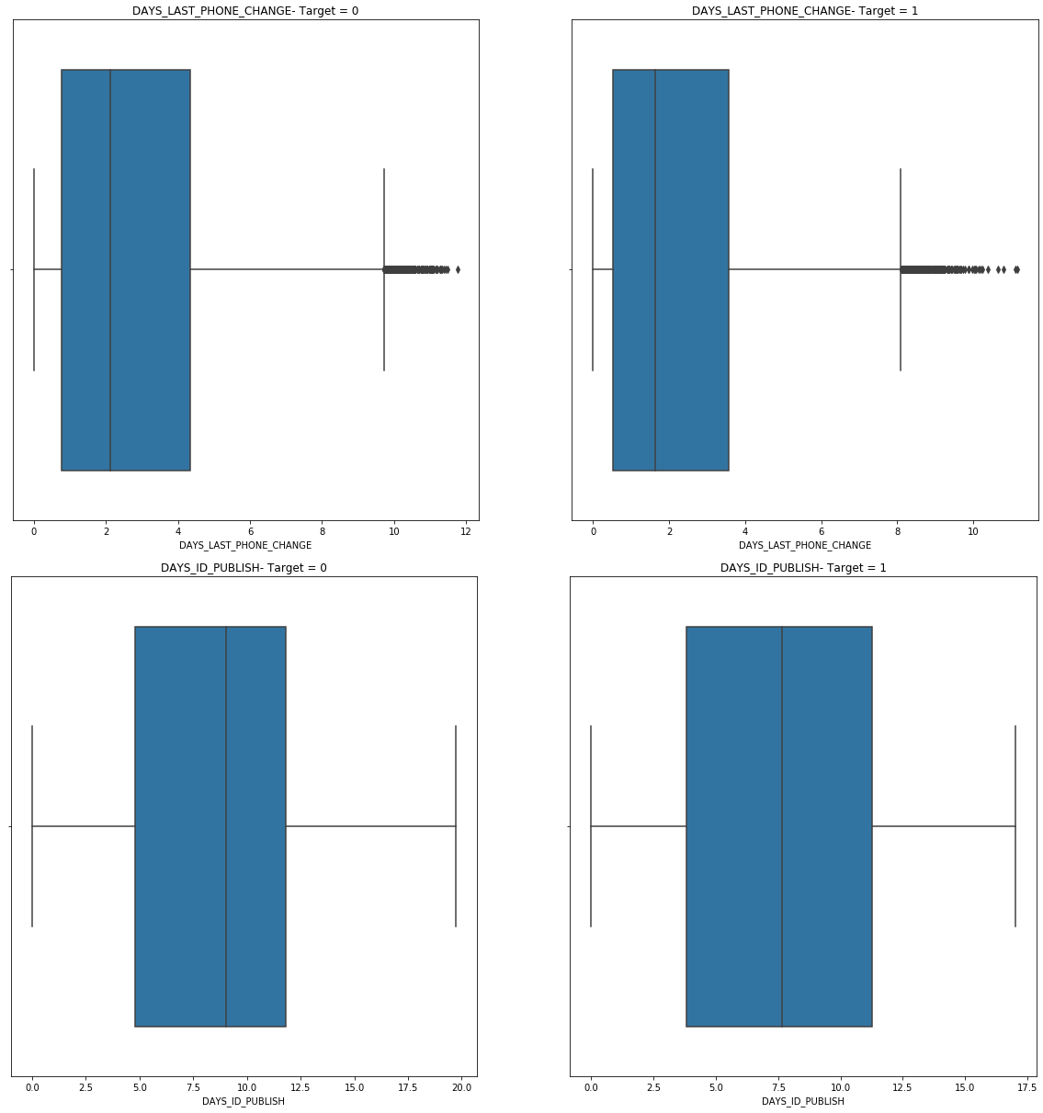
Exploring Data Sets – Numerical Variable
Univariate Exploration
We explore data set available to understand how the defaulters(target =1) and non-defaulters(target =2) are distributed around various numerical variables
Identification:
Fig 1:
DAYS_LAST_PHONE_CHANG
E: Median value and 75 percentile value for Defaulters (Target = 1) is lesser than non- defaulters. It implies defaulter more often change phone number before application
Fig 2: DAYS_ID_PUBLISH: Defaulters seem to change IDs more frequently than non-defaulters
Fig-1
Fig-2

Slide 13
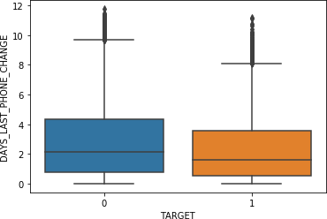
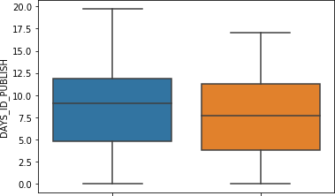
Exploring Data Sets – Numerical Variable
Bivariate Exploration
Fig-1
We explore data set available to understand how the defaulters(target =1) and non-defaulters(target =2 and various numerical variables are related
Identification: Fig 1:
DAYS_LAST_PHONE_CHAN
GE: Defaulter customers change phone number closer to the submission of application Fig 2: DAYS_ID_PUBLISH: Defaulter customers changes id closer to submission of application
Fig-2

Slide 14
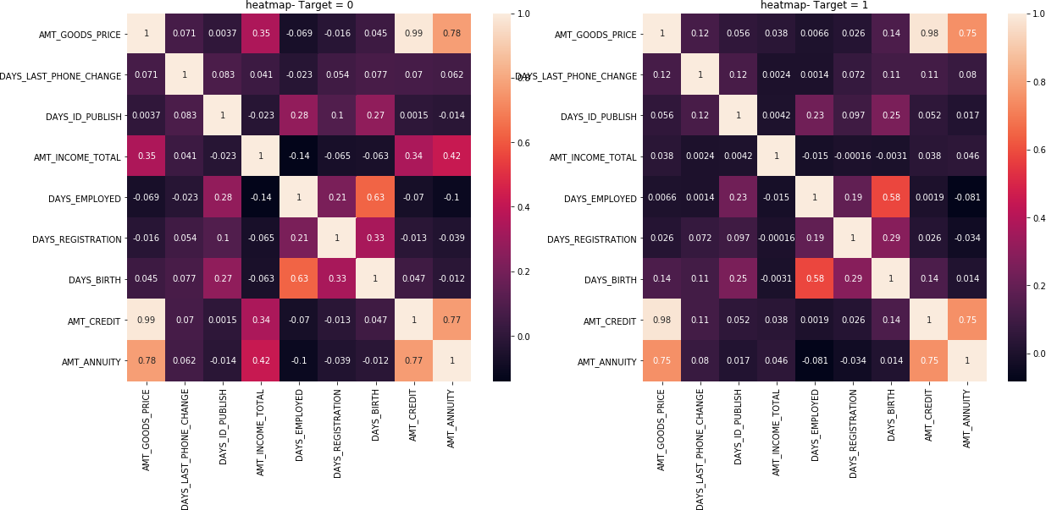
Exploring Data Sets – Numerical Variable
Correlation Analysis
We explore data sets for target =0 and target =1 to check if top 10 correlated pair of variables are same across both the data sets
Identification: Identification:
Fig 1: correlation for variables in target =0
Fig 2: correlation for variables in target =01
Though correlation values look similar for both the data sets, we will need to present values in a tubular format to do comparison
Fig-1
Fig-2

Slide 15
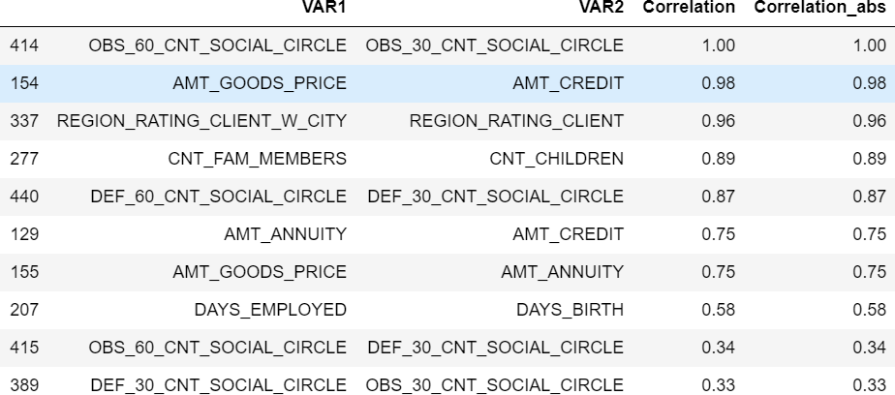
Exploring Data Sets – Numerical Variable
Fig-1
Correlation Analysis
We explore data sets for target =0 and target =1 to check if top 10 correlated pair of variables are same across both the data sets
Identification:
Fig 1: Top 10 correlation
variables for target =0
Fig 2: Top 10 correlation variables for target =1
8 out of the top 10 correlation variables are common across both the data set
Fig-2

Slide 16
Summary
As per analysis made below is the summary, which can help in predicting which customer can account to default.
S.No. | Variable | Variable Type
1 | CODE_GENDER | Categorical
2. | NAME_EDUCATION_TYPE | Categorical
3. | AGE_GROUP | Categorical
4. | NAME_HOUSING_TYPE | Categorical
5. | NAME_INCOME_TYPE | Categorical
6. | OCCUPATION_TYPE | Categorical
7. | REGION_RATING_CLIENT | Categorical
8. | REGION_RATING_CLIENT_W_CI TY | Categorical
9. | DAYS_LAST_PHONE_CHANGE | Numerical
10. | DAYS_ID_PUBLISH | Numerical

